Slide 1
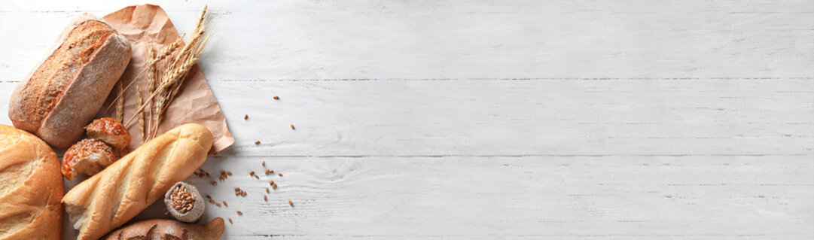

Miss Muffin Home Bakery
Miss_muffin_home_bakery
+91 9586639346

Slide 2
miss muffin home bakery
miss muffin home bakery
miss muffin home bakery
miss muffin home bakery
miss muffin home bakery
miss muffin home bakery

Slide 3
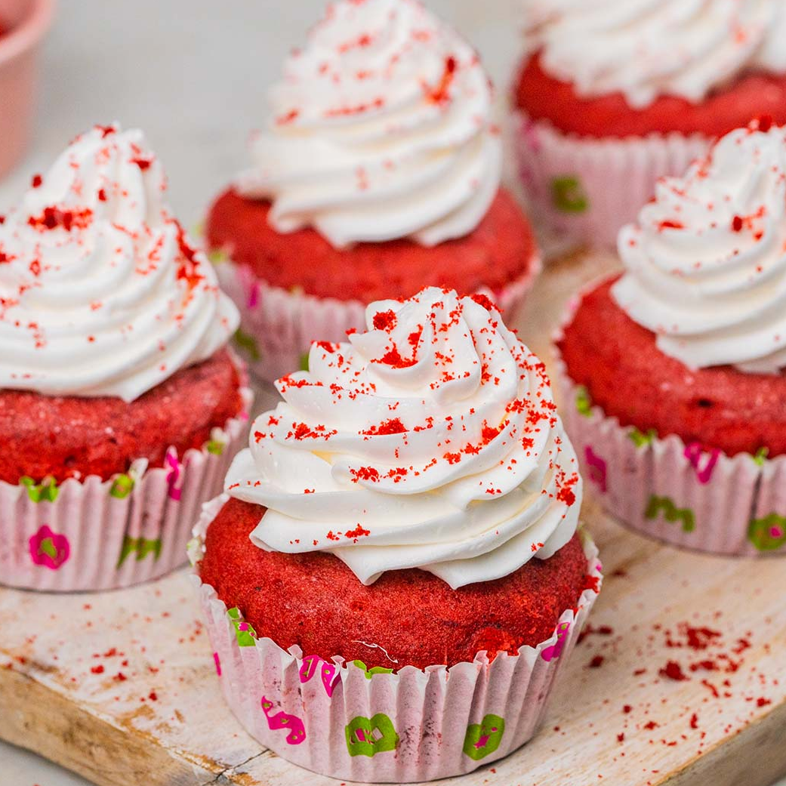

Slide 4






